Slide 1
X-section O-P
See Cross section locations.kmz & Cross section labels.kmz for location in Google Earth

Slide 2
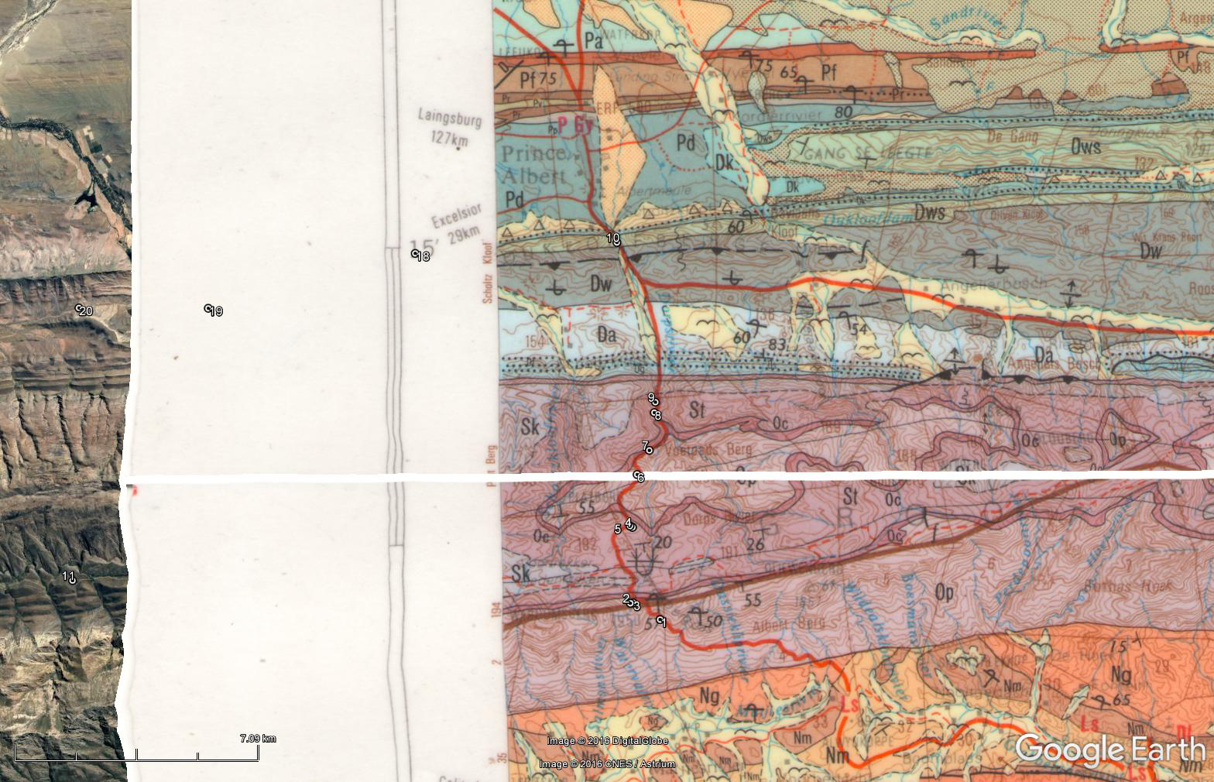

N
O
P
Teeberg
O
f
P
3 Km
3 Km
3 km east of Teeberg viewpoint
2
2
St
1
Op
St
Oc
1
Op
Pa
Pf
Pr
Pd
0
Pw
Pr
Dk
Dws
0
Pp
Pd
Dw
-1
Sb
Sk
-1
Da
St
Dg-Db
Oc
Undifferentiated Kango Group
Op
-2
-2
-3
-3
0
5
10
15
20
Km

Slide 3
N
S
N
Teeberg
P
f
O
3 Km
3 Km
3 km east of Teeberg viewpoint
2
2
St
1
Oc
St
Op
1
Op
Pd
Pr
Pf
Pa
0
Dws
Dk
Pr
Pw
0
Dw
Pd
Pp
-1
Sk
Sb
-1
St
Da
Undifferentiated Kango Group
Oc
Dg-Db
-2
Op
-2
-3
-3
Km
20
15
10
5
0

